Slide 1
Chapter 15: Security

Slide 2
Chapter 15: Security
The Security Problem
Program Threats
System and Network Threats
Cryptography as a Security Tool
User Authentication
Implementing Security Defenses
Firewalling to Protect Systems and Networks
Computer-Security Classifications
An Example: Windows XP

Slide 3
Objectives
To discuss security threats and attacks
To explain the fundamentals of encryption, authentication, and hashing
To examine the uses of cryptography in computing
To describe the various countermeasures to security attacks

Slide 4
The Security Problem
Security must consider external environment of the system, and protect the system resources
Intruders (crackers) attempt to breach security
Threat is potential security violation
Attack is attempt to breach security
Attack can be accidental or malicious
Easier to protect against accidental than malicious misuse

Slide 5
Security Violations
Categories
  Breach of confidentiality- type of voilation involves unauthorized reading of data. (credit card info)
  Breach of integrity- this violation involves unauthorized modification of data.(modification of source code of application)
  Breach of availability- unauthorized destruction of data
  Theft of service-unauthorized use of resources. (may install deamon on a system that acts as a file server.)
  Denial of service- network attack
  ATTAKER USE FOLLOWING METHODS
  Masquerading- one participant in communication pretends to be someone else.(another host or another person)
  Replay attack – repeat of valid data(request of transfer of money)
  Man in the middle attack- masquerading as the sender to the receiver and vice versa

Slide 6
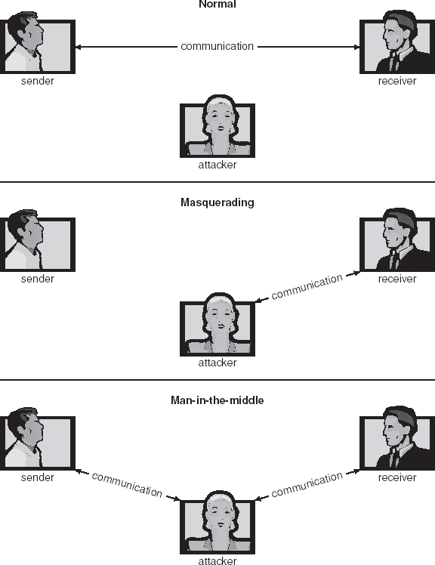
Standard Security Attacks

Slide 7
Security Measure Levels
Security must occur at four levels to be effective:
To protect system we must take security measures at four levels
  Physical= site or sites containing computer system must be physically secured against armed or surreptitious entry by intruders.
  Human- authorizing users must be done carefully to insure that only appropriate users have access to the system. Phishing= a legitimate looking email or web page misleads a user into entering confidential information.
    Avoid social engineering, phishing, dumpster diving
  Operating System= A stack overflow could allow the launching of an unauthorized processes.
  Network= data transfer over private leased line , shared lines, like internet
Security is as week as the weakest chain

Slide 8
Program Threats
Trojan Horse= most of the system have mechanism for allowing programs written by user to be executed by others. Other user might misuse these rights.1- eg text editor program, path, search 4 certain key words.
  Code segment that misuses its environment is called TH
  A variation of TH is a program that emulates a login program. Password is been stolen by login emulator, which was running on the terminal by the thief. end genuine login prompt
  Spyware,=it accompanies a program that the user has choosen to install.
  pop-up browser windows- certain sites are visited capture info from users sys and returns it to central site, covert channels – suspetious communication occures

Slide 9
Trap Door
The designer of a program might leave a hole in the software that only she is capable of using.
Trap door is in a compiler. The compiler could generate standard object code as well as trapdoor , regardless of source code being compiled.
Trapdoor pose difficult problem because, to detect them we have to analyze all the source code for all components of a system.

Slide 10
Logic bomb
Under normal conditions there would be no security hole. However, when a predefined set of parameters were met, the security hole would be created.
STACK AND BUFFER OVERFLOW
Most common way for an attacker outside the system, on a network or dial up connection, to gain unauthorized access to target system.
The attack exploits a bug in a program. It can be simple case of poor programming, in which programmer neglected to code bound checking on an input field.

Slide 11
Overflow an input field, command line argument or input buffer,-until it writes into the stack
Overwrite current return address on the stack with the with the address of the exploit code.
Write simple cod on next space on stack that includes the command that the attacker wishes to execute.
Solun = strncpy (buffer, argv[1], size of (buffer)-1)

Slide 12
C Program with Buffer-overflow Condition
#include <stdio.h>
#define BUFFER SIZE 256
int main(int argc, char *argv[])
{
char buffer[BUFFER SIZE];
if (argc < 2)
return -1;
else {
strcpy(buffer,argv[1]);
return 0;
}
}

Slide 13
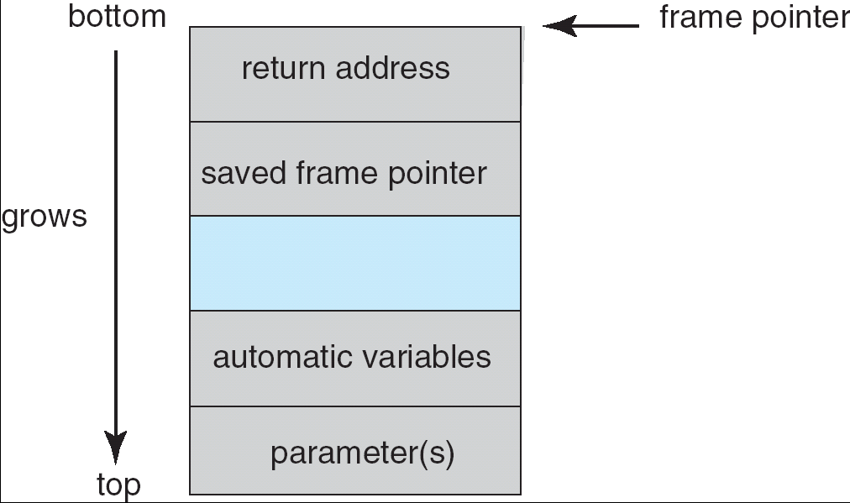
Layout of Typical Stack Frame

Slide 14
Modified Shell Code
#include <stdio.h>
int main(int argc, char *argv[])
{
execvp(‘‘\bin\sh’’,‘‘\bin \sh’’, NULL);
return 0;
}

Slide 15
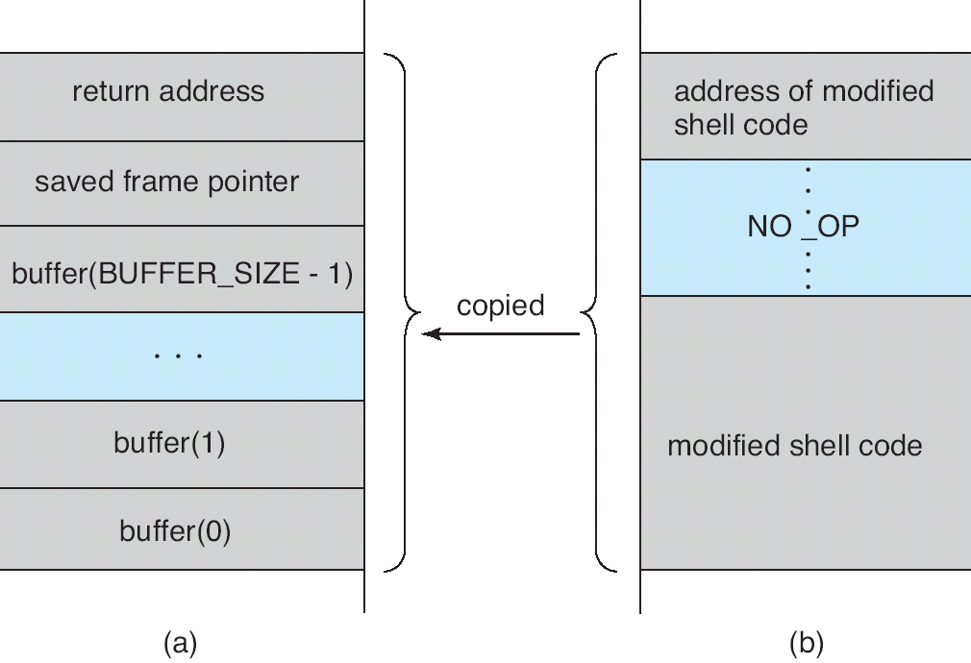
Hypothetical Stack Frame
Before attack
After attack

Slide 16
Program Threats (Cont.)
Viruses
Viruses are self replicating and designed to infect other programs.
  Code fragment embedded in legitimate program
  Very specific to CPU architecture, operating system, applications, unix is not suspectible to viruses becoz os does not support it.
  Usually borne via email or download viral programs via internet.
  Another common transmission uses Microsoft office files. These documents contain macros(VB programs).
    Visual Basic Macro to reformat hard drive
      Sub AutoOpen()
      Dim oFS
      Set oFS = CreateObject(’’Scripting.FileSystemObject’’)
      vs = Shell(’’c:command.com /k format c:’’,vbHide)
      End Sub
  thes

Slide 17
Working= once a virus reaches a target machine, a program known as virus dropper insert the virus onto system. Virus dropper is usually a TH. Once installed , virus may do any of the number of thing.

Slide 18
Program Threats (Cont.)
Virus dropper inserts virus onto the system
Many categories of viruses, literally many thousands of viruses
  File= infects a system by appending itself to a file. It changes start of a program, so execution jumps to its code. After executing it returns control to programs so that execution is not noticed .
  Boot- It infects the boot sector of the system, executing every time system is loaded. It watches other bootable ( floopy disks and infect them). These are also known as memory virus because they do not appear in files.
  Macro- written in high level lang VB. Spread sheet file
  Source code= looks for source code $ modifies it
  Polymorphic=changes each time it is installed to avoid detection by anti virus. changes does not effect virus functionality but rather changes the virus signature.
  Encrypted=it includes decryption code with encryption code, again to avoid detection.
  Stealth
  Tunneling
  Multipartite
  Armored

Slide 19
  Encrypted=it includes decryption code with encryption code, again to avoid detection.
  Stealth= tricky virus to avoid detection by modifying parts of system that could be used to detect it.
  Tunneling= installs in interrupt handler and device drivers
  Multipartite = infect multiple parts of system, including boot sector, memory, files.
  Armored= it compress to avoid detection

Slide 20
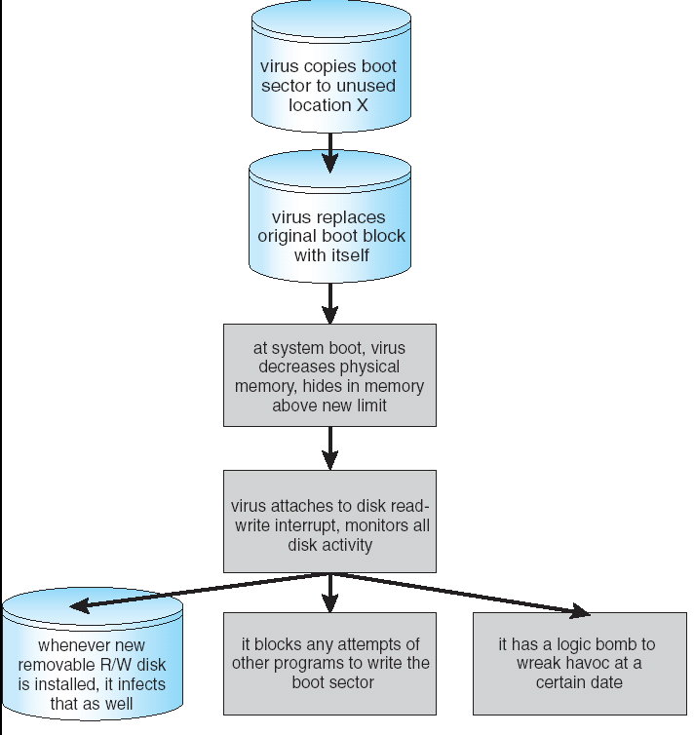
A Boot-sector Computer Virus

Slide 21
System and Network Threats
Sys and network threat creates a situation in which os sys resources and users files are misused.
Worms –
It is a self replicating program for rapid production and distribution.
The worm is made up of two programs, a grappling hook program and main program. Named l1.c, grapping hook consisted of 99 line of C code compiled and run on each machine it accessed.
Once established on the computer system under attack, the grappling hook connected to the m/c where it is originated and uploaded a copy to main worm on to hooked system
The main program proceed to search other machines to which newly infected system can connect easily.
use spawn mechanism; standalone program
Internet worm
  Exploited UNIX networking features (remote access) and bugs in finger and sendmail programs
  Grappling hook program uploaded main worm program
Port scanning
  Automated attempt to connect to a range of ports on one or a range of IP addresses
Denial of Service
  Overload the targeted computer preventing it from doing any useful work
  Distributed denial-of-service (DDOS) come from multiple sites at once

Slide 22
Port scanning
Port scanning typically automated, involving a tool that attempts to create TCP/IP connection to a specific port or a range of ports.
nmap= open source utility for network exploration and security auditing. When pointed at a target, it will determine what services are running ,including appn name and functions.
Nessus= it has database of bugs, it attempt to attack all appropriate bugs.

Slide 23
Denial of service
Network based
Fall into 2 catagories
No useful work can be done= website click could download a java applet that proceeds to use all available cputime, to infinitely pop up window
2= disturping the network of facility.
If a senser sends a part of protocol that says “the conn is now complete” partially start session, last for hour or two.

Slide 24
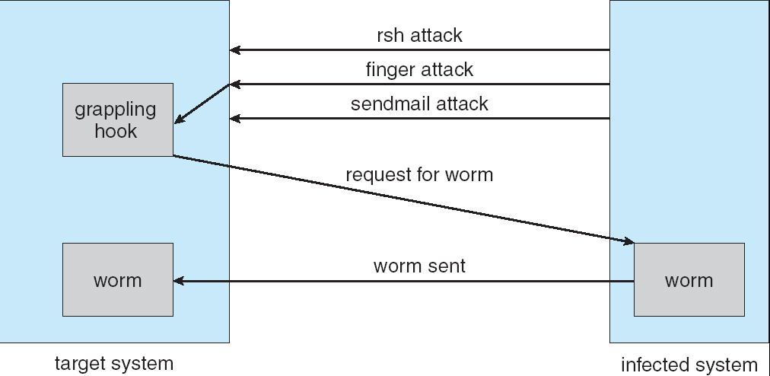
The Morris Internet Worm

Slide 25
Cryptography as a Security Tool
Broadest security tool available
  Source and destination of messages cannot be trusted without cryptography
  Means to constrain potential senders (sources) and / or receivers (destinations) of messages
Based on secrets (keys)

Slide 26
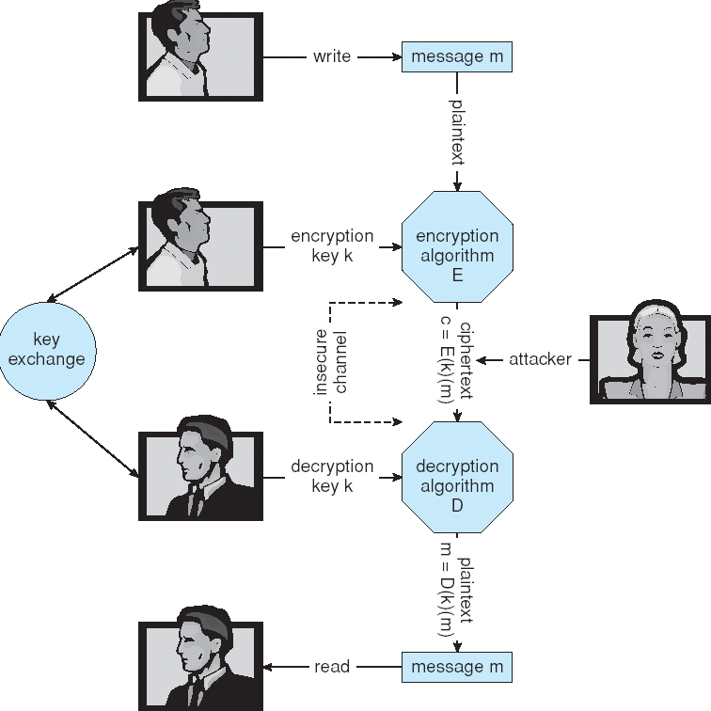
Secure Communication over Insecure Medium

Slide 27
Encryption
Encryption algorithm consists of
  Set of K keys
  Set of M Messages
  Set of C ciphertexts (encrypted messages)
  A function E : K → (M→C). That is, for each k ∈ K, E(k) is a function for generating ciphertexts from messages.
    Both E and E(k) for any k should be efficiently computable functions.
  A function D : K → (C → M). That is, for each k ∈ K, D(k) is a function for generating messages from ciphertexts.
    Both D and D(k) for any k should be efficiently computable functions.
An encryption algorithm must provide this essential property: Given a ciphertext c ∈ C, a computer can compute m such that E(k)(m) = c only if it possesses D(k).
  Thus, a computer holding D(k) can decrypt ciphertexts to the plaintexts used to produce them, but a computer not holding D(k) cannot decrypt ciphertexts.
  Since ciphertexts are generally exposed (for example, sent on the network), it is important that it be infeasible to derive D(k) from the ciphertexts

Slide 28
Symmetric Encryption
Same key used to encrypt and decrypt
  E(k) can be derived from D(k), and vice versa
DES = 64 bit vaue, key 64 bit key
Block cipher= 64 bit blocks
  Encrypts a block of data at a time
Triple-DES considered more secure= des repeated 3 times 1 enc
Advanced Encryption Standard (AES)= key length 128, 192,256,
128 bit blocks
twofish up and coming
RC4 is most common symmetric stream cipher, but known to have vulnerabilities
  Encrypts/decrypts a stream of bytes (i.e wireless transmission)
  Key is a input to psuedo-random-bit generator
    Generates an infinite keystream

Slide 29
Asymmetric Encryption
Public-key encryption based on each user having two keys:
  public key – published key used to encrypt data
  private key – key known only to individual user used to decrypt data
Must be an encryption scheme that can be made public without making it easy to figure out the decryption scheme
  Most common is RSA block cipher
  Efficient algorithm for testing whether or not a number is prime
  No efficient algorithm is know for finding the prime factors of a number

Slide 30
Asymmetric Encryption (Cont.)
Formally, it is computationally infeasible to derive D(k_{d} , N) from E(k_{e} , N), and so E(k_{e} , N) need not be kept secret and can be widely disseminated
  E(k_{e} , N) (or just k_{e}) is the public key
  D(k_{d} , N) (or just k_{d}) is the private key
  N is the product of two large, randomly chosen prime numbers p and q (for example, p and q are 512 bits each)
  Encryption algorithm is E(k_{e} , N)(m) = m^{ke} mod N, where k_{e} satisfies k_{e}k_{d} mod (p−1)(q −1) = 1
  The decryption algorithm is then D(k_{d} , N)(c) = c^{kd} mod N

Slide 31
RSA
Choose two prime nos p and q
Compute N=p*q
Choose e such that e and (p-1)(q-1) r relatively prime.
Choose d such that (e*d)[(p-1)*(q-1)] =1
Private kry=(n,d), public=(N,e)
C=Pe modN
P=Cd mod N

Slide 32
Asymmetric Encryption Example
For example. make p = 7and q = 13
We then calculate N = 7∗13 = 91 and (p−1)(q−1) = 72
We next select k_{e} relatively prime to 72 and< 72, yielding 5
Finally,we calculate k_{d} such that k_{e}k_{d} mod 72 = 1, yielding 29
We how have our keys
  Public key, k_{e,} N = 5, 91
  Private key, k_{d} , N = 29, 91
Encrypting the message 69 with the public key results in the cyphertext 62
Cyphertext can be decoded with the private key
  Public key can be distributed in cleartext to anyone who wants to communicate with holder of public key

Slide 33
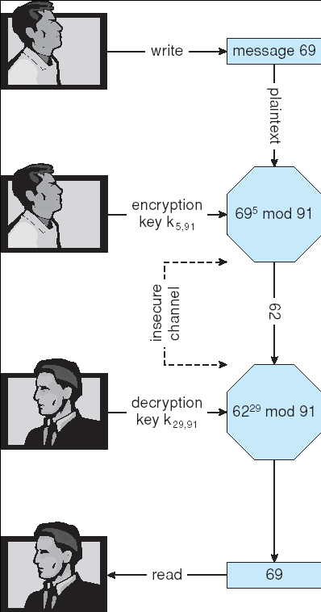
Encryption and Decryption using RSA Asymmetric Cryptography

Slide 34
Cryptography (Cont.)
Note symmetric cryptography based on transformations, asymmetric based on mathematical functions
  Asymmetric much more compute intensive
  Typically not used for bulk data encryption

Slide 35
Authentication
Au means that receiver needs to be sure of sender’s identity.
Constraining set of potential senders of a message
  Complementary and sometimes redundant to encryption
  Also can prove message unmodified
Algorithm components
  A set K of keys
  A set M of messages
  A set A of authenticators
  A function S : K → (M→ A)
    That is, for each k ∈ K, S(k) is a function for generating authenticators from messages
    Both S and S(k) for any k should be efficiently computable functions
  A function V : K → (M× A→ {true, false}). That is, for each k ∈ K, V(k) is a function for verifying authenticators on messages
    Both V and V(k) for any k should be efficiently computable functions

Slide 36
Authentication (Cont.)
For a message m, a computer can generate an authenticator a ∈ A such that V(k)(m, a) = true only if it possesses S(k)
Thus, computer holding S(k) can generate authenticators on messages so that any other computer possessing V(k) can verify them
Computer not holding S(k) cannot generate authenticators on messages that can be verified using V(k)
Since authenticators are generally exposed (for example, they are sent on the network with the messages themselves), it must not be feasible to derive S(k) from the authenticators

Slide 37
Authentication – Hash Functions
Msf→ hash fun→ msg digest
Variable length→ fixed length
Basis of authentication
Creates small, fixed-size block of data (message digest, hash value) from m
Hash Function H must be collision resistant on m
  Must be infeasible to find an m’ ≠ m such that H(m) = H(m’)
If H(m) = H(m’), then m = m’
  The message has not been modified
Common message-digest functions include MD5, which produces a 128-bit hash, and SHA-1, which outputs a 160-bit hash

Slide 38
Authentication - MAC
cryptoghraphy checksum is generated from message using secret key.
Symmetric encryption used in message-authentication code (MAC) authentication algorithm
Simple example:
  MAC defines S(k)(m) = f (k, H(m))
    Where f is a function that is one-way on its first argument
      k cannot be derived from f (k, H(m))
    Because of the collision resistance in the hash function, reasonably assured no other message could create the same MAC
    A suitable verification algorithm is V(k)(m, a) ≡ ( f (k,m) = a)
    Note that k is needed to compute both S(k) and V(k), so anyone able to compute one can compute the other

Slide 39
Authentication – Digital Signature
Based on asymmetric keys and digital signature algorithm
Authenticators produced are digital signatures
In a digital-signature algorithm, computationally infeasible to derive S(k_{s} ) from V(k_{v})
  V is a one-way function
  Thus, k_{v} is the public key and k_{s} is the private key
Consider the RSA digital-signature algorithm
  Similar to the RSA encryption algorithm, but the key use is reversed
  Digital signature of message S(k_{s} )(m) = H(m)^{ks} mod N
  The key k_{s} again is a pair d, N, where N is the product of two large, randomly chosen prime numbers p and q
  Verification algorithm is V(k_{v})(m, a) ≡ (a^{kv} mod N = H(m))
    Where k_{v} satisfies k_{v}k_{s} mod (p − 1)(q − 1) = 1

Slide 40
Authentication (Cont.)
Why authentication if a subset of encryption?
  Fewer computations (except for RSA digital signatures)
  Authenticator usually shorter than message
  Sometimes want authentication but not confidentiality
    Signed patches et al
  Can be basis for non-repudiation

Slide 41
Key Distribution
Symmetric communicates with each other using via paper or a conversation.- out-of-band
If user wants to communicate wth N other users , user needs N different keys
Asy- every user has its private key
Delivery of symmetric key is huge challenge
  Sometimes done out-of-band
Asymmetric keys can proliferate – stored on key ring
  Even asymmetric key distribution needs care – man-in-the-middle attack

Slide 42
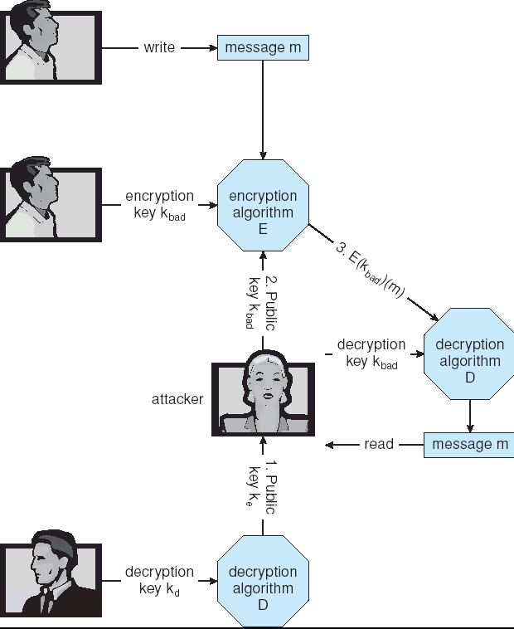
Man-in-the-middle Attack on Asymmetric Cryptography

Slide 43
Digital Certificates
Proof of who or what owns a public key
Public key digitally signed a trusted party
Trusted party receives proof of identification from entity and certifies that public key belongs to entity
Certificate authority are trusted party – their public keys included with web browser distributions
  They vouch for other authorities via digitally signing their keys, and so on

Slide 44
Encryption Example - SSL
Cryptographic protocol that enables two computer to communicate securely.
SESSion key is shared
It is forgotten after every session
Insertion of cryptography at one layer of the ISO network model (the transport layer)
SSL – Secure Socket Layer (also called TLS)
Cryptographic protocol that limits two computers to only exchange messages with each other
  Very complicated, with many variations
Used between web servers and browsers for secure communication (credit card numbers)
The server is verified with a certificate assuring client is talking to correct server
Asymmetric cryptography used to establish a secure session key (symmetric encryption) for bulk of communication during session
Communication between each computer theb uses symmetric key cryptography

Slide 45
User Authentication
Crucial to identify user correctly, as protection systems depend on user ID
User identity most often established through passwords, can be considered a special case of either keys or capabilities
  Also can include something user has and /or a user attribute
Passwords must be kept secret
  Frequent change of passwords
  Use of “non-guessable” passwords
  Log all invalid access attempts
Passwords may also either be encrypted or allowed to be used only once

Slide 46
Passwords
Most common approach of authenticating a user identity is the use of passwords.
If the password supplied matches yhe password stored in the sys, sys assumes that acc is being accessed by owner

Slide 47
Password vulnerabilities
Passworg can be gussed,
Shoulder surfing
ENCRYPTED PASSWORDS’
Unix system use encryption. The sys contain fun thatv is extermely difficult. F(x), encoded paddword is stored.

Slide 48
One time password
Paired password
One part of password pair is supplied by system and other is supplied by user.
Seed
F(secret,seed)
BIOMETRIC- palm, hand

Slide 49
Implementing Security Defenses
Defense in depth is most common security theory – multiple layers of security
Security policy describes what is being secured
Vulnerability assessment compares real state of system / network compared to security policy
Intrusion detection endeavors to detect attempted or successful intrusions
  Signature-based detection spots known bad patterns
  Anomaly detection spots differences from normal behavior
    Can detect zero-day attacks
  False-positives and false-negatives a problem
Virus protection
Auditing, accounting, and logging of all or specific system or network activities

Slide 50
Firewalling to Protect Systems and Networks
A network firewall is placed between trusted and untrusted hosts
  The firewall limits network access between these two security domains
Can be tunneled or spoofed
  Tunneling allows disallowed protocol to travel within allowed protocol (i.e. telnet inside of HTTP)
  Firewall rules typically based on host name or IP address which can be spoofed
Personal firewall is software layer on given host
  Can monitor / limit traffic to and from the host
Application proxy firewall understands application protocol and can control them (i.e. SMTP)
System-call firewall monitors all important system calls and apply rules to them (i.e. this program can execute that system call)

Slide 51
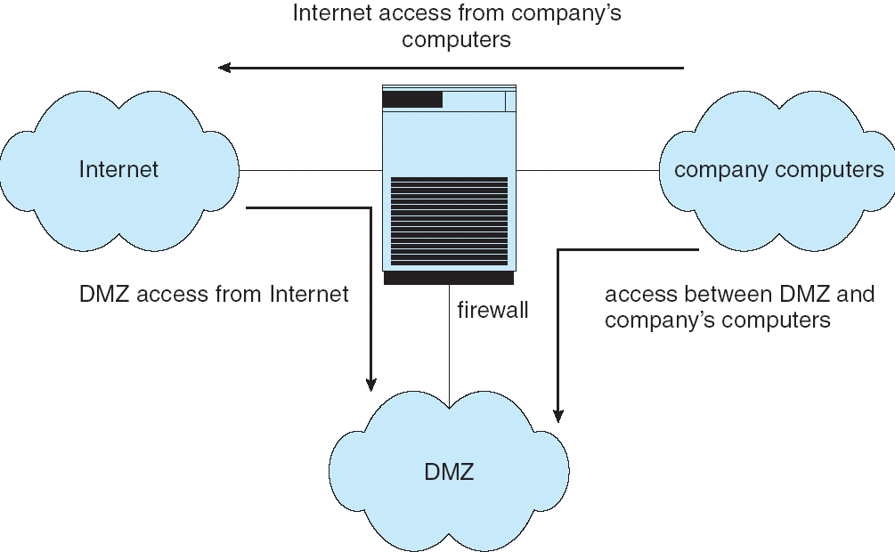
Network Security Through Domain Separation Via Firewall

Slide 52
Computer Security Classifications
U.S. Department of Defense outlines four divisions of computer security: A, B, C, and D.
D – Minimal security.
C – Provides discretionary protection through auditing. Divided into C1 and C2. C1 identifies cooperating users with the same level of protection. C2 allows user-level access control.
B – All the properties of C, however each object may have unique sensitivity labels. Divided into B1, B2, and B3.
A – Uses formal design and verification techniques to ensure security.

Slide 53
Example: Windows XP
Security is based on user accounts
  Each user has unique security ID
  Login to ID creates security access token
    Includes security ID for user, for user’s groups, and special privileges
    Every process gets copy of token
    System checks token to determine if access allowed or denied
Uses a subject model to ensure access security. A subject tracks and manages permissions for each program that a user runs
Each object in Windows XP has a security attribute defined by a security descriptor
  For example, a file has a security descriptor that indicates the access permissions for all users

Slide 54
End of Chapter 15

